Slide 1

Greedy Technique

Slide 2
Greedy Technique
Constructs a solution to an optimization problem piece by
piece through a sequence of choices that are:
feasible, i.e. satisfying the constraints
locally optimal (with respect to some neighborhood definition)
greedy (in terms of some measure), and irrevocable
For some problems, it yields a globally optimal solution for every instance. For most, does not but can be useful for fast approximations. We are mostly interested in the former case in this class.
Defined by an objective function and a set of constraints

Slide 3
Applications of the Greedy Strategy
Optimal solutions:
change making for “normal” coin denominations
minimum spanning tree (MST)
single-source shortest paths
simple scheduling problems
Huffman codes
Approximations/heuristics:
traveling salesman problem (TSP)
knapsack problem
other combinatorial optimization problems

Slide 4
Change-Making Problem
Given unlimited amounts of coins of denominations d₁ > … > d_{m} ,
give change for amount n with the least number of coins
Example: d₁ = 25c, d₂ =10c, d₃ = 5c, d₄ = 1c and n = 48c
Greedy solution:
Greedy solution is
optimal for any amount and “normal’’ set of denominations
may not be optimal for arbitrary coin denominations
Q: What are the objective function and constraints?
<1, 2, 0, 3>
Ex: Prove the greedy algorithm is optimal for the above denominations.
For example, d1 = 25c, d2 = 10c, d3 = 1c, and n = 30c

Slide 5
Minimum Spanning Tree (MST)
Spanning tree of a connected graph G: a connected acyclic subgraph of G that includes all of G’s vertices
Minimum spanning tree of a weighted, connected graph G: a spanning tree of G of the minimum total weight
Example:
6
c
6
c
c
a
a
a
4
1
4
1
1
2
2
d
d
d
b
3
b
b
3

Slide 6
Spanning trees
Suppose you have a connected undirected graph
Connected: every node is reachable from every other node
Undirected: edges do not have an associated direction
...then a spanning tree of the graph is a connected subgraph in which there are no cycles
A connected, undirected graph
Four of the spanning trees of the graph

Slide 7
Finding a spanning tree
To find a spanning tree of a graph,
pick an initial node and call it part of the spanning tree
do a search from the initial node:
each time you find a node that is not in the spanning tree, add to the spanning tree both the new node and the edge you followed to get to it
An undirected graph
One possible result of a BFS starting from top
One possible result of a DFS starting from top

Slide 8
Minimizing costs
Suppose you want to supply a set of houses (say, in a new subdivision) with:
electric power
water
sewage lines
telephone lines
To keep costs down, you could connect these houses with a spanning tree (of, for example, power lines)
However, the houses are not all equal distances apart
To reduce costs even further, you could connect the houses with a minimum-cost spanning tree

Slide 9
Minimum-cost spanning trees
Suppose you have a connected undirected graph with a weight (or cost) associated with each edge
The cost of a spanning tree would be the sum of the costs of its edges
A minimum-cost spanning tree is a spanning tree that has the lowest cost
16
16
A
B
A
B
21
11
6
11
6
19
5
5
F
C
F
C
33
14
10
E
18
D
E
18
D
A connected, undirected graph
A minimum-cost spanning tree

Slide 10
Finding spanning trees
There are two basic algorithms for finding minimum-cost spanning trees, and both are greedy algorithms
Kruskal’s algorithm: Start with no nodes or edges in the spanning tree, and repeatedly add the cheapest edge that does not create a cycle
Here, we consider the spanning tree to consist of edges only
Prim’s algorithm: Start with any one node in the spanning tree, and repeatedly add the cheapest edge, and the node it leads to, for which the node is not already in the spanning tree.
Here, we consider the spanning tree to consist of both nodes and edges

Slide 11
Prim’s MST algorithm
Start with tree T₁ consisting of one (any) vertex and “grow” tree one vertex at a time to produce MST through a series of expanding subtrees T₁, T₂, …, T_{n}
On each iteration, construct T_{i+1} from T_{i} by adding vertex not in T_{i} that is closest to those already in T_{i} (this is a “greedy” step!)
Stop when all vertices are included

Slide 12
Example
4
c
4
c
4
c
a
a
a
1
1
1
6
6
6
2
2
2
d
d
d
b
3
b
3
b
3
4
c
4
c
a
a
1
1
6
6
2
2
d
d
b
3
b
3

Slide 13
Notes about Prim’s algorithm
Efficiency
O(n²) for weight matrix representation of graph and array implementation of priority queue
O(m log n) for adjacency lists representation of graph with n vertices and m edges and min-heap implementation of the priority queue

Slide 14
Prim’s algorithm
Starting from empty T, choose a vertex at random and initialize
V = {1), E’ ={}

Slide 15
Prim’s algorithm
Choose the vertex u not in V such that edge weight from u to a vertex in V is minimal (greedy!)
V={1,3} E’= {(1,3) }

Slide 16
Prim’s algorithm
Repeat until all vertices have been chosen
Choose the vertex u not in V such that edge weight from v to a vertex in V is minimal (greedy!)
V= {1,3,4} E’= {(1,3),(3,4)}
V={1,3,4,5} E’={(1,3),(3,4),(4,5)}
….
V={1,3,4,5,2,6}
E’={(1,3),(3,4),(4,5),(5,2),(2,6)}

Slide 17
Prim’s algorithm
Repeat until all vertices have been chosen
V={1,3,4,5,2,6}
E’={(1,3),(3,4),(4,5),(5,2),(2,6)}
Final Cost: 1 + 3 + 4 + 1 + 1 = 10

Slide 18
Prim’s Algorithm Implementation
Assume adjacency list representation
Initialize connection cost of each node to “inf” and “unmark” them
Choose one node, say v and set cost[v] = 0 and prev[v] =0
While they are unmarked nodes
Select the unmarked node u with minimum cost; mark it
For each unmarked node w adjacent to u
if cost(u,w) < cost(w) then cost(w) := cost (u,w)
prev[w] = u

Slide 19
Another greedy algorithm for MST: Kruskal’s
Sort the edges in nondecreasing order of lengths
“Grow” tree one edge at a time to produce MST through a series of expanding forests F₁, F₂, …, F_{n-1}
On each iteration, add the next edge on the sorted list unless this would create a cycle. (If it would, skip the edge.)

Slide 20
Example
4
c
4
c
4
c
a
a
a
1
1
1
6
6
6
2
2
2
d
d
d
b
3
b
3
b
3
4
c
c
c
a
a
a
1
1
1
6
6
2
2
2
d
d
d
b
3
b
3
b
3

Slide 21
Notes about Kruskal’s algorithm
Algorithm looks easier than Prim’s but is harder to implement (checking for cycles!)
Cycle checking: a cycle is created iff added edge connects vertices in the same connected component
Runs in O(m log m) time, with m = |E|. The time is mostly spent on sorting.

Slide 22
Minimum spanning tree vs. Steiner tree
1
a
c
a
c
1
1
vs
s
b
d
b
d
1
In general, a Steiner minimal tree (SMT) can be much shorter than a minimum spanning tree (MST), but SMTs are hard to compute.

Slide 23
Kruskal’s Algorithm
Select edges in order of increasing cost
Accept an edge to expand tree or forest only if it does not cause a cycle
Implementation using adjacency list, priority queues and disjoint sets

Slide 24
Example

Slide 26
Step 1
Select edge with lowest cost (2,5)
Find(2) = 2, Find (5) = 5
Union(2,5)
F= {{1},{2,5},{3},{4},{6}}
1 edge accepted
1

Slide 27
Step 2
Select edge with lowest cost (2,6)
Find(2) = 2, Find (6) = 6
Union(2,6)
F= {{1},{2,5,6},{3},{4}}
2 edges accepted
1
1

Slide 28
Step 3
Select edge with lowest cost (1,3)
Find(1) = 1, Find (3) = 3
Union(1,3)
F= {{1,3},{2,5,6},{4}}
3 edges accepted
1
1
1

Slide 29
Step 4
Select edge with lowest cost (5,6)
Find(5) = 2, Find (6) = 2
Do nothing
F= {{1,3},{2,5,6},{4}}
3 edges accepted
1
1
1

Slide 30
Step 5
Select edge with lowest cost (3,4)
Find(3) = 1, Find (4) = 4
Union(1,4)
F= {{1,3,4},{2,5,6}}
4 edges accepted
1
3
1
1

Slide 31
Step 6
Select edge with lowest cost (4,5)
Find(4) = 1, Find (5) = 2
Union(1,2)
F= {{1,3,4,2,5,6}}
5 edges accepted : end
Total cost = 10
Although there is a unique spanning tree in this example, this is not generally the case
1
3
1
4
1

Slide 32
Kruskal’s Algorithm Analysis
Initialize forest O(n)
Initialize heap O(m), m = |E|
Loop performed m times
In the loop one DeleteMin O(log m)
Two Find, each O(log n)
One Union (at most) O(1)
So worst case O(m log m) = O(m log n)

Slide 33
Time Complexity Summary
Recall that m = |E| = O(V²) = O(n² )
Prim’s runs in O((n+m) log n)
Kruskal runs in O(m log m) = O(m log n)
In practice, Kruskal has a tendency to run faster since graphs might not be dense and not all edges need to be looked at in the Deletemin operations

Slide 34
Dijkstra’s Algorithm

Slide 35
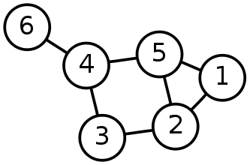
Single-Source Shortest Path Problem
Single-Source Shortest Path Problem - The problem of finding shortest paths from a source vertex v to all other vertices in the graph.

Slide 36
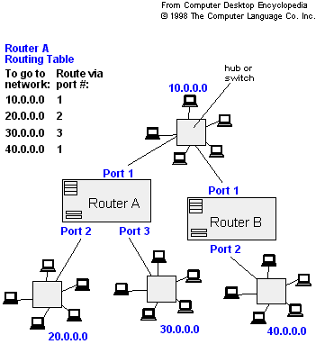
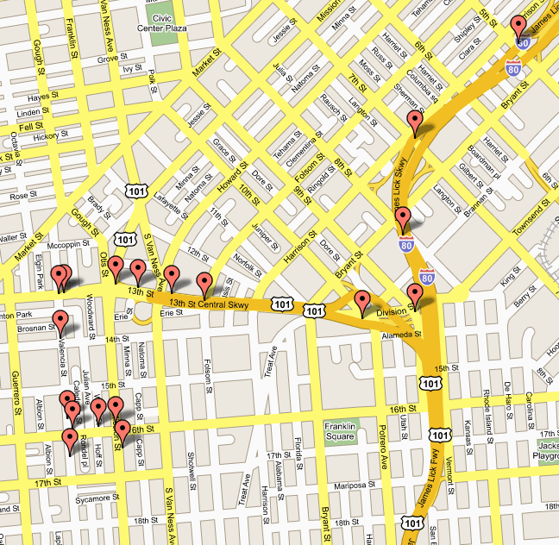
Applications
- Maps (Map Quest, Google Maps)
- Routing Systems

Slide 37
Dijkstra's algorithm
Dijkstra's algorithm - is a solution to the single-source shortest path problem in graph theory.
Works on both directed and undirected graphs. However, all edges must have nonnegative weights.
Input: Weighted graph G={E,V} and source vertex v∈V, such that all edge weights are nonnegative
Output: Lengths of shortest paths (or the shortest paths themselves) from a given source vertex v∈V to all other vertices

Slide 38
Approach
The algorithm computes for each vertex u the distance to u from the start vertex v, that is, the weight of a shortest path between v and u.
the algorithm keeps track of the set of vertices for which the distance has been computed, called the cloud C
Every vertex has a label D associated with it. For any vertex u, D[u] stores an approximation of the distance between v and u. The algorithm will update a D[u] value when it finds a shorter path from v to u.
When a vertex u is added to the cloud, its label D[u] is equal to the actual (final) distance between the starting vertex v and vertex u.

Slide 39
Dijkstra pseudocode
Dijkstra(v1, v2):
for each vertex v: // Initialization
v's distance := infinity.
v's previous := none.
v1's distance := 0.
List := {all vertices}.
while List is not empty:
v := remove List vertex with minimum distance.
mark v as known.
for each unknown neighbor n of v:
dist := v's distance + edge (v, n)'s weight.
if dist is smaller than n's distance:
n's distance := dist.
n's previous := v.
reconstruct path from v2 back to v1,
following previous pointers.

Slide 40
Example: Initialization
Distance(source) = 0
0
∞
Distance (all vertices but source) = ∞
A
2
B
4
1
3
10
∞
C
2
D
2
E
∞
5
8
∞
4
6
F
1
G
∞
∞
Pick vertex in List with minimum distance.

Slide 41
Example: Update neighbors' distance
0
2
A
2
B
4
1
3
10
∞
C
2
D
2
E
∞
5
8
1
4
6
Distance(B) = 2
F
1
G
Distance(D) = 1
∞
∞

Slide 42
Example: Remove vertex with minimum distance
0
2
A
2
B
4
1
3
10
∞
C
2
D
2
E
∞
5
8
1
4
6
F
1
G
∞
∞
Pick vertex in List with minimum distance, i.e., D

Slide 43
Example: Update neighbors
0
2
A
2
B
4
1
3
10
3
C
2
D
2
E
3
5
8
1
4
6
Distance(C) = 1 + 2 = 3 Distance(E) = 1 + 2 = 3 Distance(F) = 1 + 8 = 9 Distance(G) = 1 + 4 = 5
F
1
G
9
5

Slide 44
Example: Continued...
Pick vertex in List with minimum distance (B) and update neighbors
0
2
A
2
B
4
1
3
10
3
C
2
D
2
E
3
5
8
1
4
6
Note : distance(D) not updated since D is already known and distance(E) not updated since it is larger than previously computed
F
1
G
9
5

Slide 45
Example: Continued...
Pick vertex List with minimum distance (E) and update neighbors
0
2
A
2
B
4
1
3
10
3
C
2
D
2
E
3
5
8
1
4
6
F
1
G
No updating
9
5

Slide 46
Example: Continued...
Pick vertex List with minimum distance (C) and update neighbors
0
2
A
2
B
4
1
3
10
3
C
2
D
2
E
3
5
8
1
4
6
Distance(F) = 3 + 5 = 8
F
1
G
8
5

Slide 47
Example: Continued...
Pick vertex List with minimum distance (G) and update neighbors
0
2
A
2
B
4
1
3
10
3
C
2
D
2
E
3
5
8
1
4
6
F
1
G
Previous distance
6
5
Distance(F) = min (8, 5+1) = 6

Slide 48
Example (end)
0
2
A
2
B
4
1
3
10
3
C
2
D
2
E
3
5
8
1
4
6
F
1
G
6
5
Pick vertex not in S with lowest cost (F) and update neighbors

Slide 49
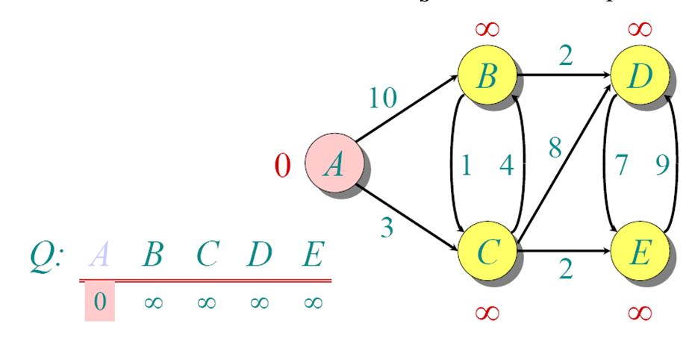
Another Example

Slide 50
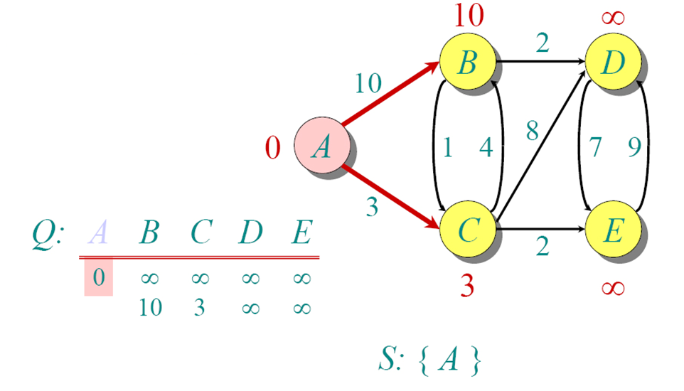
Another Example

Slide 51
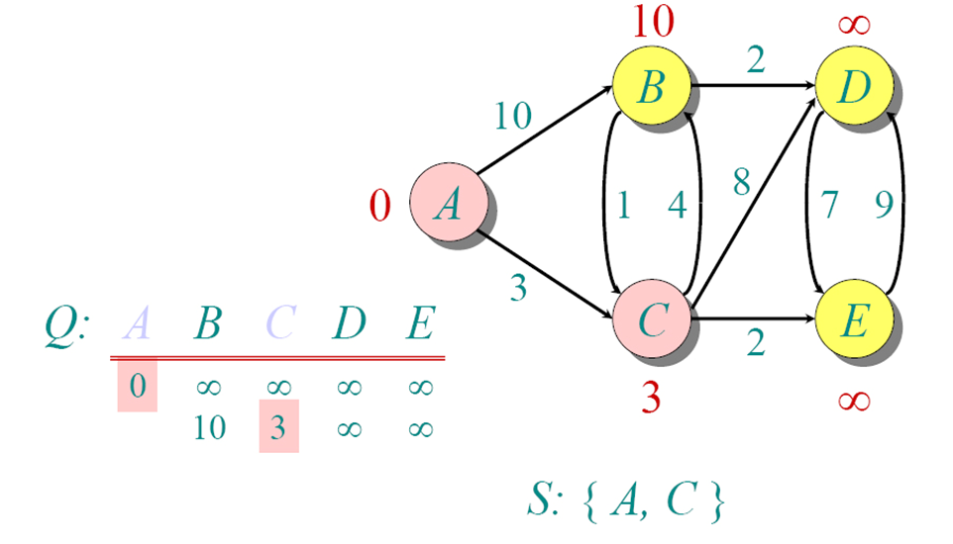
Another Example

Slide 52
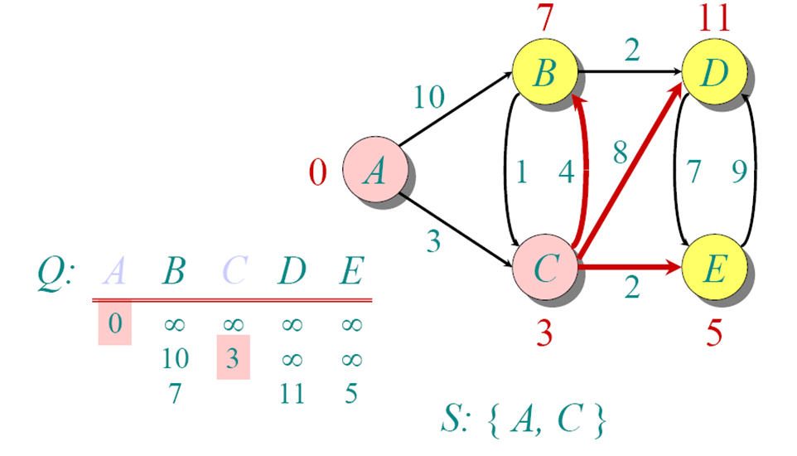
Another Example

Slide 53
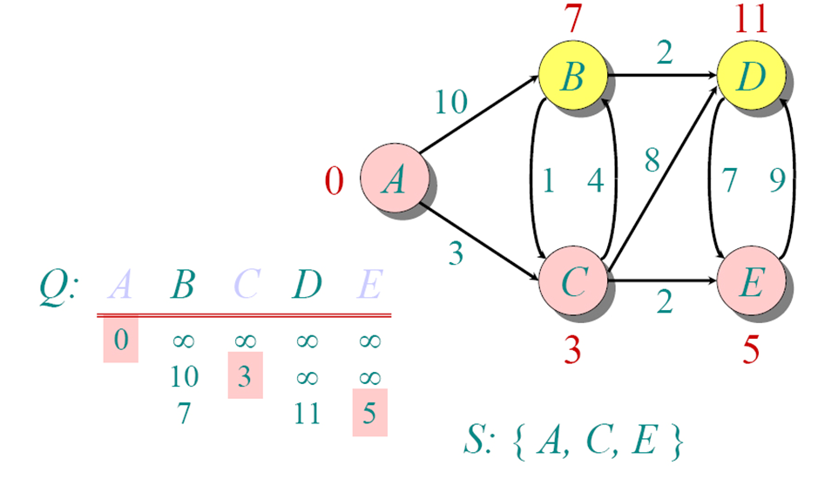
Another Example

Slide 54
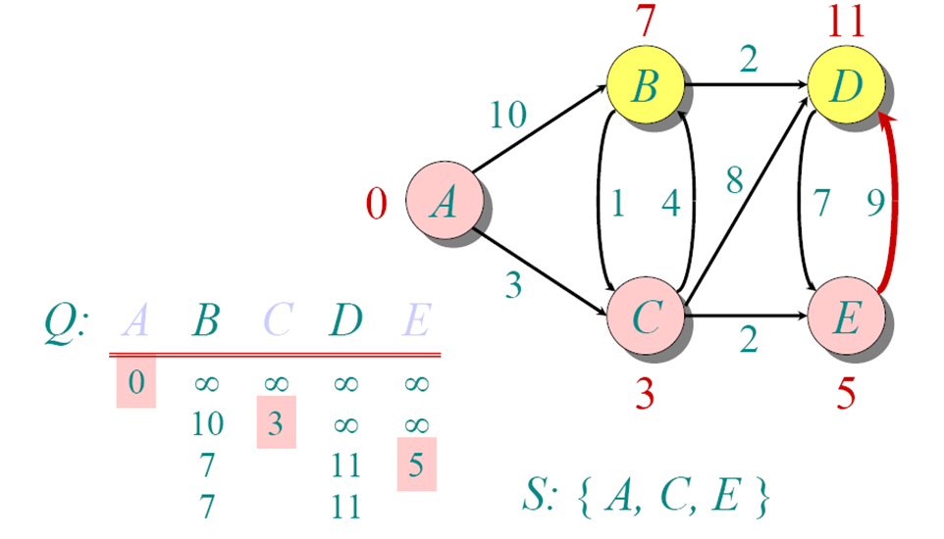
Another Example

Slide 55
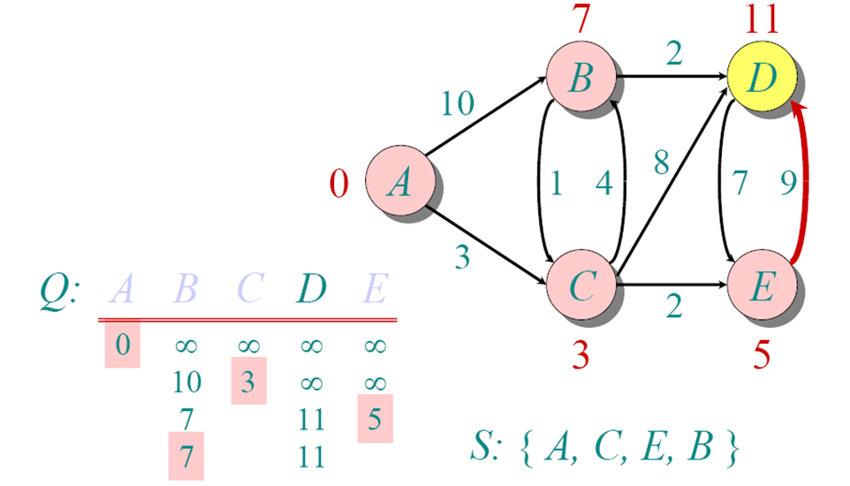
Another Example

Slide 56
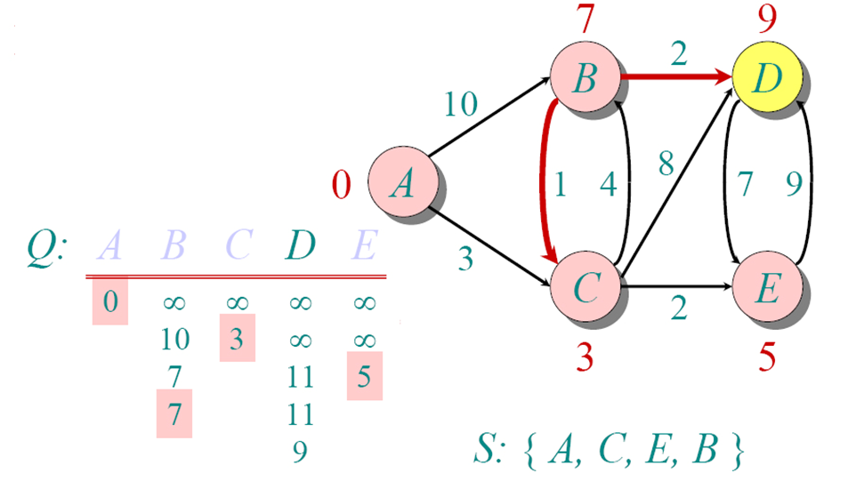
Another Example

Slide 57
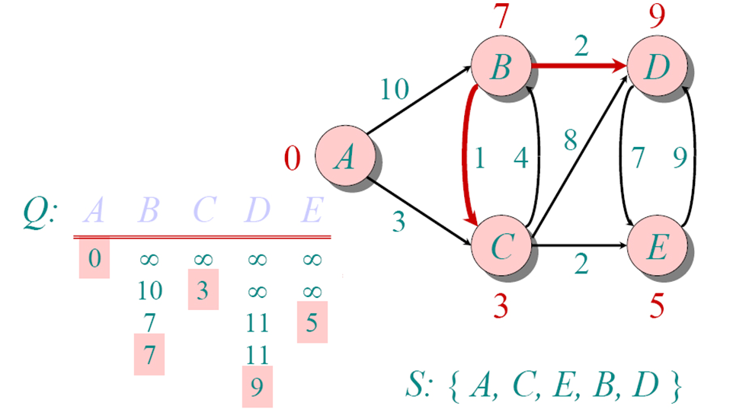
Another Example

Slide 58
Time Complexity: Using List
The simplest implementation of the Dijkstra's algorithm stores vertices in an ordinary linked list or array
Good for dense graphs (many edges)
|V| vertices and |E| edges
Initialization O(|V|)
While loop O(|V|)
Find and remove min distance vertices O(|V|)
Potentially |E| updates
Update costs O(1)
Total time O(|V²| + |E|) = O(|V²| )

Slide 59
Time Complexity: Priority Queue
For sparse graphs, (i.e. graphs with much less than |V²| edges) Dijkstra's implemented more efficiently by priority queue
Initialization O(|V|) using O(|V|) buildHeap
While loop O(|V|)
Find and remove min distance vertices O(log |V|) using O(log |V|) deleteMin
Potentially |E| updates
Update costs O(log |V|) using decreaseKey
Total time O(|V|log|V| + |E|log|V|) = O(|E|log|V|)
|V| = O(|E|) assuming a connected graph

